Slide 1

Deduplication Scheme For Cloud Data Based
On Convergent Encryption
by
B.SARATH KUMAR
Roll No. 194G5A0506
K.LATHASRI
Roll No. 184G1A0534
S.R.G.GNANA DEEPIKA
Roll No. 184G1A0517
T.NAVYA DEEPTHI
Roll No. 184G1A0554
Under the guidance of
Dr. C. Sasikala _{M.Tech., Ph.D}
Associate Professor
Department of Computer Science and Engineering
Srinivasa Ramanujan Institute of Technology
(Affiliated to JNTUA & Approved by AICTE) (Accredited by NAAC with ‘A’ Grade & Accredited by NBA (EEE, ECE & CSE)
Rotarypuram Village, B K Samudram Mandal, Ananthapuramu – 515701.
2021 - 2022

Slide 2
Review 0 Remarks
What is Convergent Encryption?
Convergent Encryption is nothing but it converts the same plaintext into same ciphertext.
How you find that the given data was a duplicate data ?
By using Convergent Encryption (CE) we will be finding the duplicate data provided by the user.

Slide 3
Review 1 Remarks
How will you authenticate the users ?
We will be authenticating the users by verfying the username and the password.
Is it possible to compare two ciphertexts?
By using Convergent Encryption technique we can compare two different ciphertext.

Slide 4
Review 2 Remarks
Which type of data we are using for finding duplicate data?
We are using text based data files for finding duplicate data.
How many data block chunks are used?
Four metadata chunks are used.

Slide 5
Contents
Abstract
Introduction
Existing System
Proposed System
Literature Survey
Problem Definition
Planning
Requirements
Design
Data Flow Diagram
Implementation
Sample Code
Screenshots
Conclusion
References

Slide 6
Abstract
Cloud computing is a powerful technology that provides a way of storing voluminous data that can easily be accessed anywhere and any time. Deduplication is nothing but the elimination of duplicate or redundant information. Deduplication scheme based on convergent encryption (CE) is widely-used in cloud storage system to eliminate redundant data. In addition, previous works usually introduce the third-party auditors to execute the data integrity verification, suffering from data disclosure by the auditors.
Deduplication scheme based on Convergent Encryption, this will detect and eliminate redundant data by keeping only one copy of the data, aiming to save the storage space.

Slide 7
Introduction
Cloud computing has been widely-used in IT industry nowadays, which efficiently allocates the computational resources and with the development of cloud computing, more and more users choose to outsource their data to the cloud storage service provider which may lead to storage of redundent data.
A promising approach to remove repeated data is through data Deduplication. In generally, the users can utilize different encryption scheme here we are using convergent encryption.

Slide 8
Existing System
In the existing system usually we introduce the third-party auditors to execute the data integrity verification, suffering from data attacks by the attackers. Commonly attacks like Brute-force attack, Collusion attack will occur. Existing Systems transfer application metadata to block-layer deduplication, so as to accelerate the deduplication speed. And separate metadata from data to improve the storage efficiency of deduplication. While these existing systems address metadata management, they do not consider how to mitigate metadata storage overhead in deduplication. There is less efficiency on the cloud data due to high storage overhead of metadata.
In this existing system we use only encryption. Here two identical data will be encrypted into different ciphertexts, which makes it possible to store redundant data in the cloud that may lead to usage of more cloud space storage.

Slide 9
Proposed System
In order to improve storage and security comparing to existing systems, we developed a secure authorized deduplication scheme based on convergent Encryption.
In this system we use a method called Deduplication scheme based on convergent encryption (CE) to eliminate redundant data.
Here, two identical data will be encrypted into same ciphertexts, which makes it impossible to store redundant data in the cloud.

Slide 10
Literature Survey
[1] [Jingwei Li, Suyu Huang, Yanjing Ren] - ” Enabling Secure and Space-Effificient Metadata Management in Encrypted Deduplication”.
The paper focuses on new encrypted deduplication storage system called Metadedup, which suppresses metadata storage by also applying deduplication to metadata. Its idea builds on indirection, which adds another level of metadata chunks that record metadata information. This find that metadata chunks are highly redundant in real-world workloads and hence can be effectively deduplicated. This further extend Metadedup to incorporate multiple servers via a distributed key management approach, so as to provide both fault-tolerant storage and security gaurantees.
[2] [Xiong et al. Xiong, Zhang, and Li]- ” A novel role symmetric encryption (RSE) algorithm and a RSE-based proof of ownership (RSE-PoW)”.
This paper focuses on serious privacy concerns and poses new security challenges, such as privacy leakage, the side-channel attack and unauthorized access. to solve these issues, a novel role symmetric encryption (RSE) algorithm and a RSE-based proof of ownership (RSE-PoW) scheme for secure deduplication in hierarchical heterogeneous environments, which is based on the role symmetric encryption, proof of ownership and bloom filter. The proposed scheme is the first solution to prevent the privacy leakage and resist against the side-channel attacks, meanwhile, achieve the authorized deduplication effectively for data in heterogeneous network.

Slide 11
Contd..
[3][M. Bellare. S. Keelveedhi, and T. Ristenpart] - ” Message-locked encryption and secure deduplication”.
The paper focuses on which will help to achieve a secured symmetric encryption scheme in which the the key generation under which encryption and decryption are performed is itself derived from the message. MLE provides a way to achieve secure deduplication (space-efficient secure outsourced storage), a goal currently targeted by numerous cloud-storage providers. This provide definitions both for privacy and for a form of integrity that this call tag consistency.
[4][Puzio et al]-” A Metadata Managers (MM) to the cloud storage system to store the metadata”.
The paper focuses on semantically secure encryption schemes render various cost-effective storage optimization techniques, such as data deduplication, ineffective. A novel idea that differentiates data according to their popularity. Based on this idea, designed an encryption scheme that guarantees semantic security for unpopular data and provides weaker security and better storage and bandwidth benefits for popular data which can achieve block-level authorized deduplication and confidentiality at the same time.

Slide 12
Problem Definition
Cloud is playing an important role in data management and other type of services which provides secured way of data handling and remote data accessing where users from any where can use cloud for data access. Where involvement of third-party auditors leads to data privacy leakage.
To achieve a secure authorization and to avoid the problem of storing similar data multiple times which leads to shortage of storage space in the cloud. We proposed a technique called Deduplication scheme for cloud data based on Convergent Encryption. And also to protect the user data from attacks.

Slide 13
Planning
Weeks | Tasks
Week 1 | Gathering the requirements needed for the project. Downloading the required software’s and gaining knowledge regarding the development of project in detail.
Week 2 | Implementing the java server pages for developing the interactive web pages. Researching and implementing metadata chunks.
Week 3 | Creating a database for uploading and downloading the data files. Implementing convergent encryption technique.
Week 4 | Testing and producing the results and its documentation.
Week 5 | Report generation and document submission.

Slide 14
Requirements
Operating System : Windows 10
Processor : Intel I3(min)
RAM : 4 GB (min)
Hard Disk : 1 TB
Coding Language : Java(JSP,Servlet)
Tool : Java jdk, NetBeans IDE
Front End : Java
Back End : MySQL

Slide 15
Design
In the proposed system, the data will be encrypted by using Convergent Encryption technique. Our system model includes three modules including Data User, End User, Cloud Server.
The data user uploads their data into the cloud server. For the security purpose the data user encrypts the data file blocks and then store in the cloud. They can check the duplication of the file blocks over corresponding cloud server. The Data user can have capable of manipulating the encrypted data file blocks and the data user can check the cloud data as well as the duplication of the specific file blocks and also he can create remote user with respect to registered cloud servers. The data user also checks data integrity proof on which the block is modified by the attacker.

Slide 16
Contd..
The cloud server manages the cloud to provide data storage service. Data user encrypt their data files blocks and store them in the cloud for sharing with remote user. To access the shared data file’s blocks, data consumers download encrypted data file’s blocks of their interest from the cloud and then decrypt them.
The end user module, remote user logs in by using his user name and password. After he will request for secrete key of required file blocks from cloud servers, and get the secrete key. After getting secrete key he is trying to download file’s blocks by entering file’s blocks name and secrete key from cloud server.

Slide 17



System Model
1. Upload Files (checks for duplicate files)
3. Request Files
4.Provides Files
2. Return result
Data User
End User
Cloud Server

Slide 18
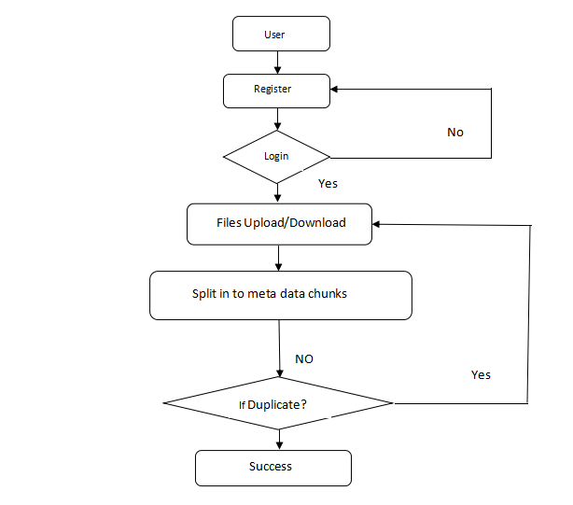
Data Flow Diagram

Slide 19
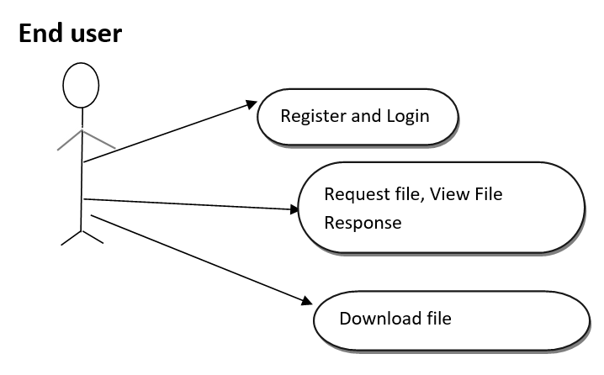
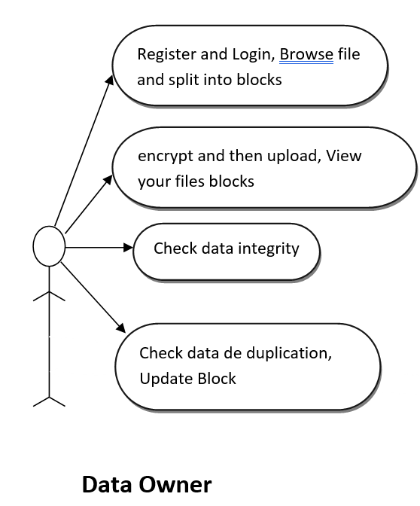
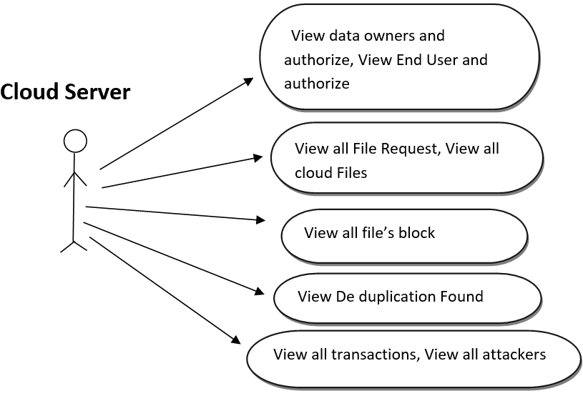
Use Case Diagram

Slide 20
Implementation
Fields for registering the user:
The following are the fields that are required for registering,
User Name
User id and password
Mobile No
Address
Gender
Pincode
Location
Profile Picture

Slide 21
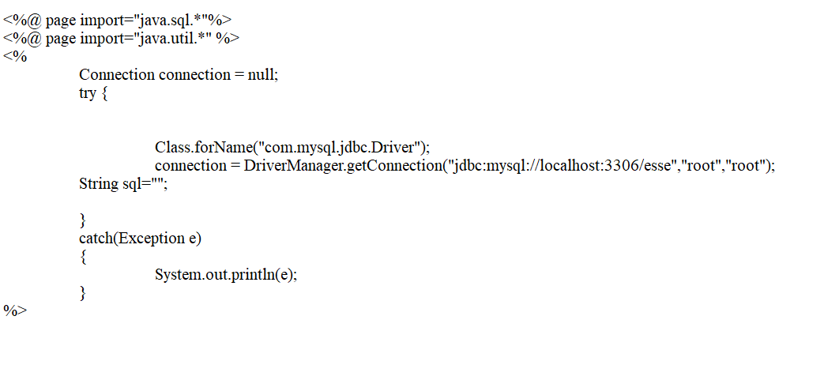
Contd..
Fields to login :
In order the login the user and data owner need to enter the following crendentials
User id and
Password
Then Java server page code is used for connecting the jsp files to Mysql database.

Slide 22
Contd..
The files uploaded by the data user will split into metadata chunks and this encrypted data files will be checked for deduplication process by the cloud server. If duplicate data files are found a message, will be shown to the data user to upload another files otherwise cloud server stores the copy of the file. Likewise an end user who has authentication, can request a file to the cloud server. Upon acceptance of the cloud server an end user can get a key and decrypt to view and download a file from the cloud server.
To run the project install netbeans ide and mysql database.

Slide 23
Sample Code
<!DOCTYPE html PUBLIC "-//W3C//DTD XHTML 1.0 Transitional//EN" "http://www.w3.org/TR/xhtml1/DTD/xhtml1-transitional.dtd">
<html xmlns="http://www.w3.org/1999/xhtml">
<head>
<title>Deduplication Scheme For Cloud Data Based On Convergent Encryption</title>
<meta http-equiv="Content-Type" content="text/html; charset=utf-8" />
<link href="css/style.css" rel="stylesheet" type="text/css" />
<link rel="stylesheet" type="text/css" href="css/coin-slider.css" />
<script type="text/javascript" src="js/cufon-yui.js"></script>
<script type="text/javascript" src="js/droid_sans_400-droid_sans_700.font.js"></script>
<script type="text/javascript" src="js/jquery-1.4.2.min.js"></script>
<script type="text/javascript" src="js/script.js"></script>
<script type="text/javascript" src="js/coin-slider.min.js"></script>
<style type="text/css">
<!--
.style1 {
font-size: 24px;
color: #FF0000;
font-weight: bold;
}
.style3 {
color: #FF0000;
font-weight: bold;
}
.style4 {color: #0000FF}
.style5 {
color: #0000FF;
font-weight: bold;
font-style: italic;
}
.style6 {font-style: italic}
.style7 {color: #FF0000}
.style8 {font-style: italic; color: #FF0000; }
-->
</style>
</head>
<body>
<div class="main">
<div class="header">
<div class="header_resize">
<div class="menu_nav">
<ul>
<li class="active"><a href="index.html"><span>Home Page</span></a></li>
<li><a href="DataUser.jsp"><span>Data User </span></a></li>
<li><a href="CloudServer.jsp"><span>Cloud Server </span></a></li>
<li><a href="EndUser.jsp"><span>End User </span></a></li>
</ul>

Slide 24
Contd..
</div>
<div class="clr"></div>
<div class="logo">
<h1><span class="style1"><a href="index.html" class="style1"></a>Deduplication Scheme For Cloud Data Based On Convergent Encryption</span></h1>
</div>
<div class="clr"></div>
<div class="slider">
<div id="coin-slider"> <a href="#"><img src="images/slide1.jpg" width="960" height="360" alt="" /> </a> <a href="#"><img src="images/slide2.jpg" width="960" height="360" alt="" /> </a> <a href="#"><img src="images/slide3.jpg" width="960" height="360" alt="" /> </a> </div>
<div class="clr"></div>
</div>
<div class="clr"></div>
</div>
</div>
<div class="content">
<div class="content_resize">
<div class="mainbar">
<div class="article">
<h2><span>WELCOME TO DATA USER LOGIN </span></h2>
<p class="infopost">&nbsp; <a href="#" class="com"></a></p>
<div class="clr"></div>
<div class="img"></div>
<div class="post_content">
<form action="Authentication.jsp" method="post" id="leavereply">
<ol>
<li>
<span class="style8">
<label for="name"><strong>Name (required)</strong></label>
</span><span class="style6"><span class="style7"> <strong>
<input id="name" name="userid" class="text" />
</strong></span></span></li>
<li>
<span class="style7"><em><strong>
<label for="email">Password (required)</label>
</strong></em></span><strong>
<input type="password" id="pass" name="pass" class="text" />
<label for="email"></label>
</strong>
<label for="email"></label>
</li>
<li><a href="Register.html"><strong>REGISTER</strong></a>
<input name="imageField" type="submit" class="style3" id="imageField" value="Login" />
<input name="Reset" type="reset" class="style3" value="Reset" />
</li>
<li></li>

Slide 25
Contd..
<li><br />
</li>
</ol>
</form>
<p class="spec"><a href="#" class="rm">..</a></p>
</div>
<div class="clr"></div>
</div>
</div>
<div class="sidebar">
<div class="searchform">
<form id="formsearch" name="formsearch" method="post" action="#">
<span>
<input name="editbox_search" class="editbox_search" id="editbox_search" maxlength="80" value="Search our ste:" type="text" />
</span>
<input name="button_search" src="images/search.gif" class="button_search" type="image" />
</form>
</div>
<div class="clr"></div>
<div class="gadget">
<h2 class="star"><span>Home </span> Menu</h2>
<div class="clr"></div>
<ul class="sb_menu">
<div class="clr"></div>
<ul class="sb_menu">
<li><a href="index.html">Home</a></li>
<li><a href="DataUser.jsp">Data User </a></li>
<li><a href="CloudServer.jsp">Cloud Server </a></li>
<li><a href="EndUser.jsp">End User </a></li>
</ul>
</div>
</div>
<div class="clr"></div>
</div>
</div>
<div class="fbg"></div>
<div class="footer">
</html>

Slide 26
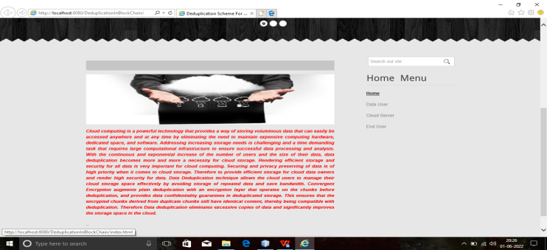
Screenshots
The below page shows Home Page of the application.

Slide 27
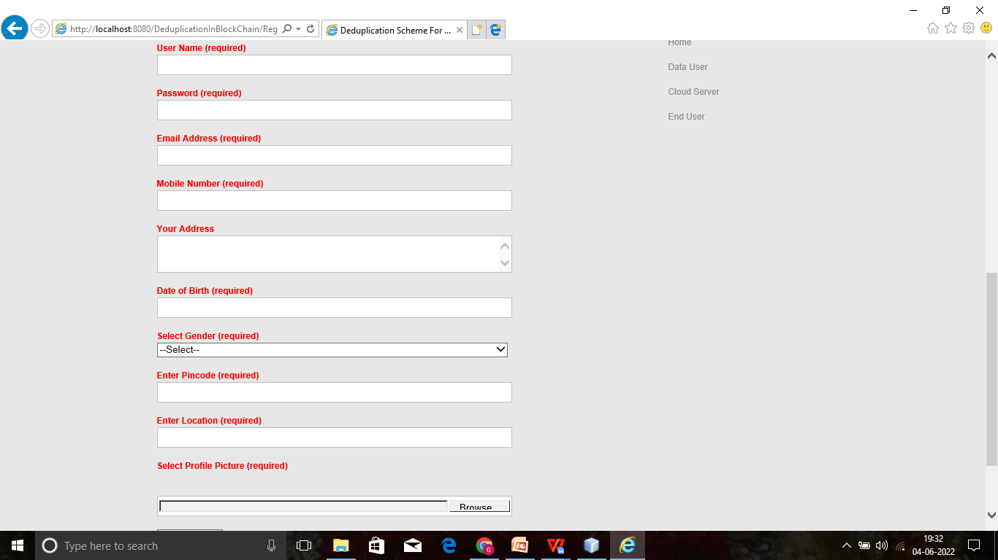
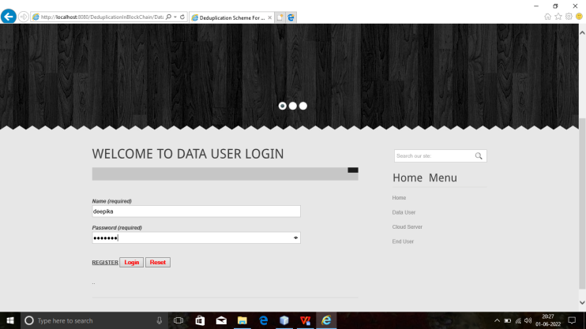
Data User Login/Register
In the next step click on register and login to enter into the data user page.

Slide 28
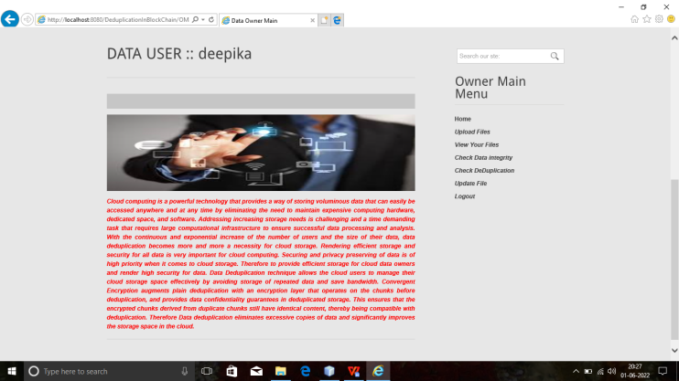
Data User Fields
The below are the fields that can be accessed by the data user. Now the data user clicks on upload files.

Slide 29
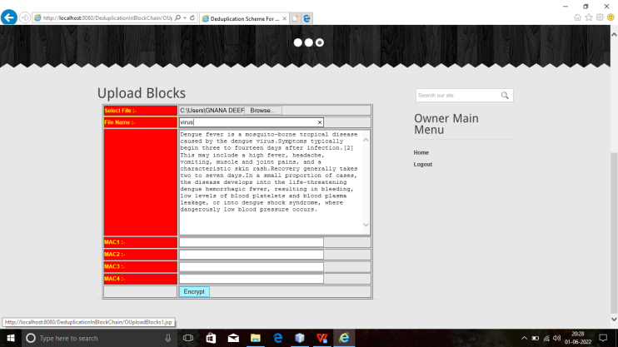
Upload File
Now the data user need to select one file from his device and give a name to it inorder to store in the cloud. And click on encrypt button.

Slide 30
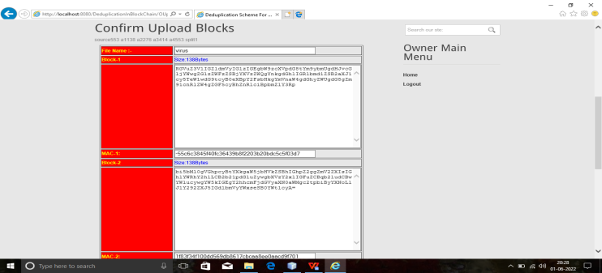
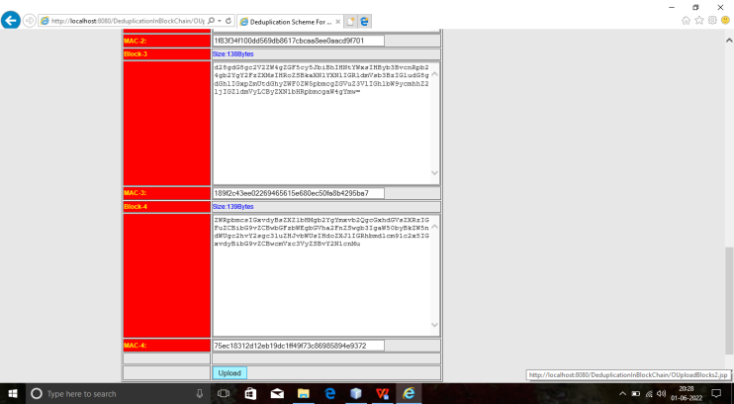
Data File Blocks
Now the data file is divided into four blocks of chunks and click on upload.

Slide 31
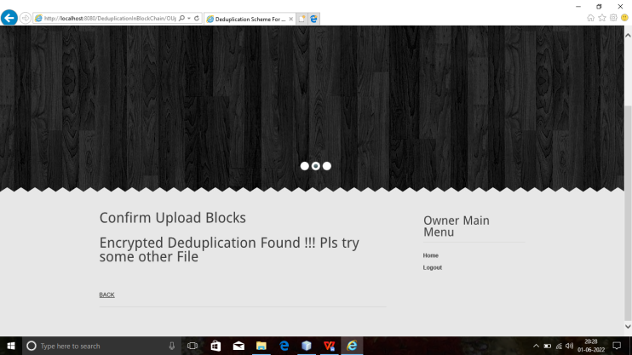
Duplicate File
After uploading the cloud server checks for duplicate files, if duplicate files are found the below message is displayed to the user.

Slide 32
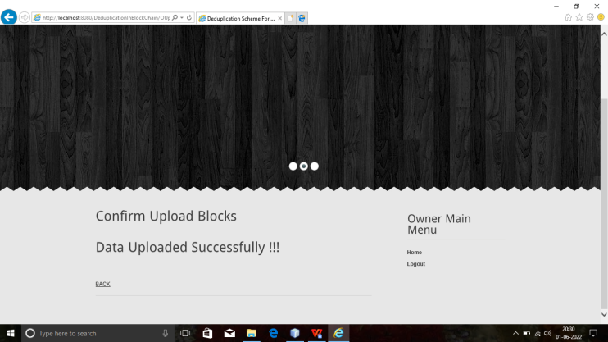
Uploaded File
If no duplicate files are found the data file is successfully uploaded into the cloud and below message is displayed to the data user.

Slide 33
Conclusion
The main goal is to remove the duplicate data files and improve the storage space in the cloud that are uploaded by the data user.So we proposed a Deduplication Scheme For Cloud Data Based On Convergent Encryption. Encrypted deduplication combines encryption and deduplication in a continuing way to provide confidentiality ensures for the physical data in deduplicated storage. Convergent Encryption guarantees that the encrypted chunks derived from replica chunks nonetheless have identical content material, thereby being well suited with deduplication. Therefore Data deduplication eliminates excessive copies of records and significantly improves the storage area inside the cloud server.

Slide 34
Reference
[1]. Jingwei Li, Suyu Huang, Yanjing Ren, Zuoru Yang, Patrick P. C. Lee, Xiaosong Zhang, and Yao Hao, “Enabling Secure and Space-Effificient Metadata Management in Encrypted Deduplication,” published by IEEE Transactions on Computers , 2021.Reference Link
[2]. M. Bellare, S. Keelveedhi, and T. Ristenpart.,“Message-locked encryption and secure deduplication,” In Proc. of EUROCRYPT, 2013.Reference Link
[3]. Taek-Young Youn1,Ku-Young Chang, “Authorized Cient-side Deduplcation Using Access Policy-based Convergent Encryption,“ Journal of Internet Technology Volume 19 No.4 , 2018.Reference Link

Slide 35
Thank You!!!

